Slide 1
Deep Neural Network and Its Alternatives
Tao Wang (t.wang@sas.com)
Senior Manager, AI and Machine Learning R&D
SAS Institute Inc.
September 2018

Slide 2
Part 1:
Deep Neural Networks
(DNN)

Slide 3
What is Machine Learning (ML)…
…and its relationship to Artificial Intelligence (AI)?
A method of data analysis that automates analytical model building.
A branch of AI: machines should learn through experience.
It has been widely quoted that the first definition of machine learning was established by Arthur Samuel, a pioneer in AI and ML.
AI = a broader idea where a machine can execute tasks “smartly”
AI applies ML and other techniques to solving actual problems.
Machine learning is a “field of study that gives computers the ability to learn without being explicitly programmed.” – Arthur Samuel, 1959

Slide 4
Styles of Machine Learning
Supervised
Unsupervised
Semi-Supervised
Reinforcement
Other styles from different perspectives (active learning, transfer learning, multi-task learning, adversarial learning, …)
Training data has labelled target
Predict label for unseen data
Labels unknown
Find patterns and gain insights from the data
Labels are known for a subset of data
A blend of supervised and unsupervised learning
An agent selects actions to maximize reward in an environment
Face detection, fraud detection, patient identification
Customer clustering
Association rule mining
Pre-processing for supervised learning to reduce labelling cost and enhance accuracy
Game AI
Robotics

Slide 5
What Can Machine Learning Do?
And so many other things!
Data Exploration
Prediction
Rule
Learning
Decision and Policy-Making
Clustering
Dimension reduction
Anomaly detection
Feature engineering
Classification
Regression
Identifying relational rules within data
Association rule mining
Learning through trial and error to identify best action
Game playing
Control problems
Often unsupervised learning
Also supervised and semi-supervised learning
Supervised learning
Semi-supervised learning
Supervised learning
Unsupervised learning
Semi-supervised learning
Reinforcement learning

Slide 6
Deep Learning: Model with Depth
Model with one or a few layers
Multiple layers, layer-by-layer processing
Feature extraction/transformation
Learn complex structures
Deep Learning
Shallow
Model
Data
Data
Model
Output
Layer
Output
Layer
Layer
Deep Learning (DL) = Deep Neural Networks (DNN) for most people

Slide 7
Pros and cons
Advantages
Flexible structures
Learning often improves with more data
Requires minimal feature engineering (end-to-end ML)
Proven track records in speech/text processing and image/video recognition
Disadvantages
Long training time, over-fitting
Hard to train, non-repeatable results, numerous architectures/hyper-parameters
Requires a large amount of training data to get good models
Difficult to interpret – often treated as a “black-box” model

Slide 8
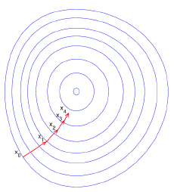
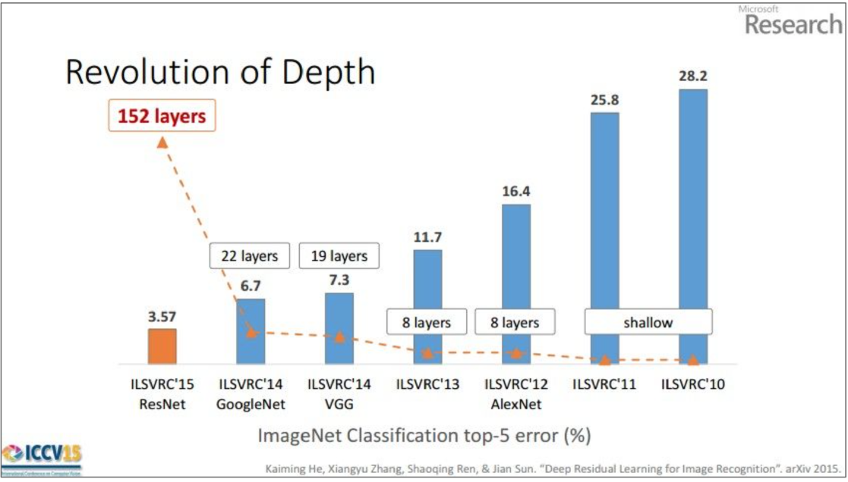
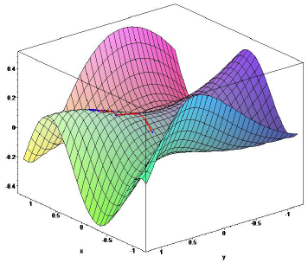
Why so popular?
End2end/distributed representation learning
Advances in algorithms/optimizations (min-batch, drop-out, BN, SGD, etc.)
Cloud computing and GPU made it possible to train very deep models
Proven track records in speech/text processing and image/video recognition
Source: images courtesy of [6]

Slide 9
More about DNN
Common DNN architectures
Deep Forward Nets
Convolutional neural networks (CNN)
Recurrent neural networks (RNN)
Stacked auto-encoders
When should I use DNN?
Deal with image/video/text/speech
Works for small-medium data, but prefers big data
The underlying model is complex and non-linear
OK with non-interpretability, have cloud/GPU

Slide 10
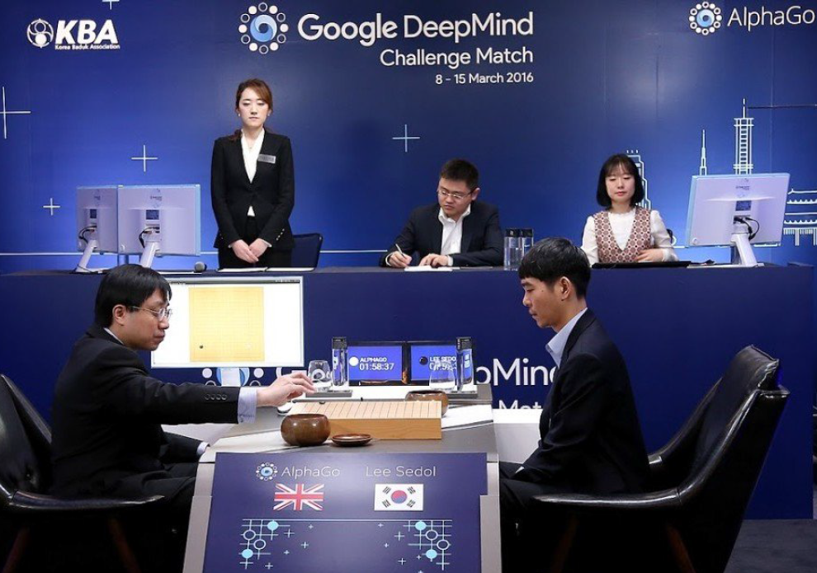
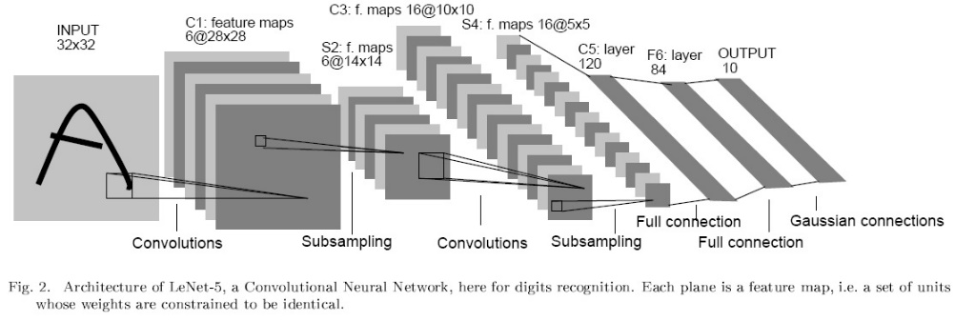
History
From LeNet to AlphaZero
LeNet 1989
CNN [1] Demo, handwritten digit recognition → ATM reading checks [2]
Google DeepMind 2016-2017
AlphaGo [3], value/policy DNN: evaluate positions & select moves, RL: self-play, MCT search: play
AlphaGoZero: requires zero human knowledge
AlphaZero (masters chess in 4 hours)

Slide 11
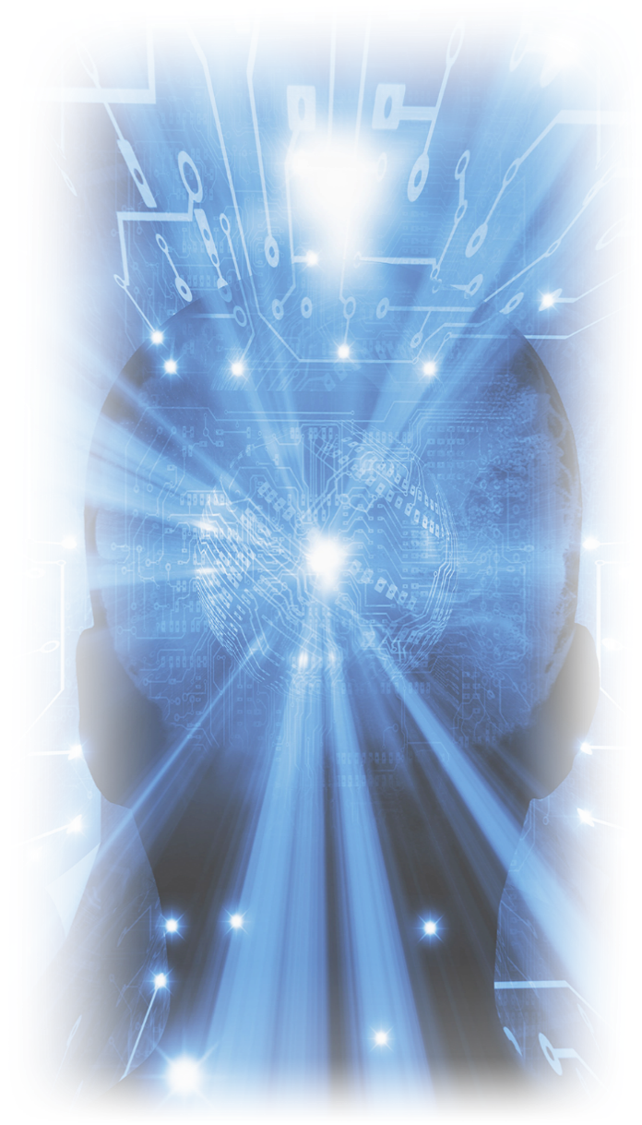
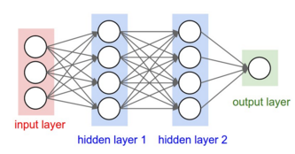
DNN architectures
Deep Forward Net
A flat architecture
Regression and classification
1

Slide 12
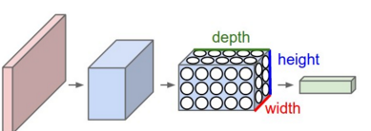
DNN architectures
Convolutional neural network (CNN)
A feedforward neural net with conv layers
3D volumes of neurons
Feature extraction
Applications: image/video recognition, NLP
2

Slide 13
DNN architectures
Recurrent neural network (RNN)
Contain at least one feed-back connection
Time-series forecasting, speech recognition
delay
3
h₁(t-1)
h₁(t)

Slide 14
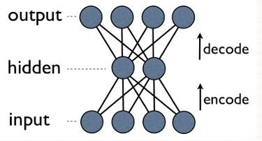
DNN architectures
Auto-encoder
A generative graphical model
Feature coding, dimension reduction and compression
4

Slide 15
Comparison with Other Algorithms
Algorithm | Problem Type | Average predictive accuracy | Perform well on small data sets | Predictive accuracy for very-large data sets (10B rows) | Handles lots of irrelevant features | Automatically learning feature
Linear regression | Regression | Lower | Yes | Lower | No | No
Logistic regression | Classification | Lower | Yes | Lower | No | No
Naïve Bayes | Classification | Lower | Yes | Lower | No | No
Decision tree | Either | Lower | Yes | Lower | No | No
Random Forest | Either | Higher | No | Higher | Yes | Sort of
SVM | Either | Higher | Yes | Hard to do | No | No
DNN | Either | Higher | No | Highest | Yes | Yes

Slide 16
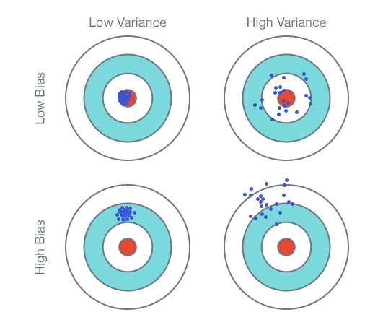
Bias and variance
Image source: blog.fliptop.com/blog/2015/03/02/bias-variance-and-overfitting-machine-learning-overview/

Slide 17
Underfitting and overfitting
Underfitting
ML model does not describe the data well enough
Overfitting
ML model describes the data well but also captures the noise
Overfitting is often a bigger problem

Slide 18
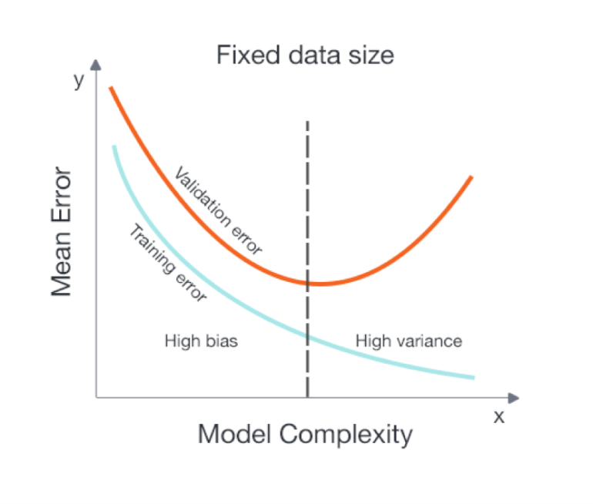
Overfitting in DNN
How big is your data?
Small-medium data: cross validation
Big data: early stopping
Reduce feature or reduce its weight?
Variable/feature selection/reduction
Regularization
Pruning: reduce the model complexity
DNN with big data = overfitting is less severe (you have seen it all)
Image source: blog.fliptop.com/blog/2015/03/02/bias-variance-and-overfitting-machine-learning-overview/

Slide 19


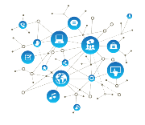
Applications
Input
Patient Identification
Speech recognition
DNN
Fraud
Detection
Image
classification
Autonomous Vehicles
Military
Surveillance

Slide 20
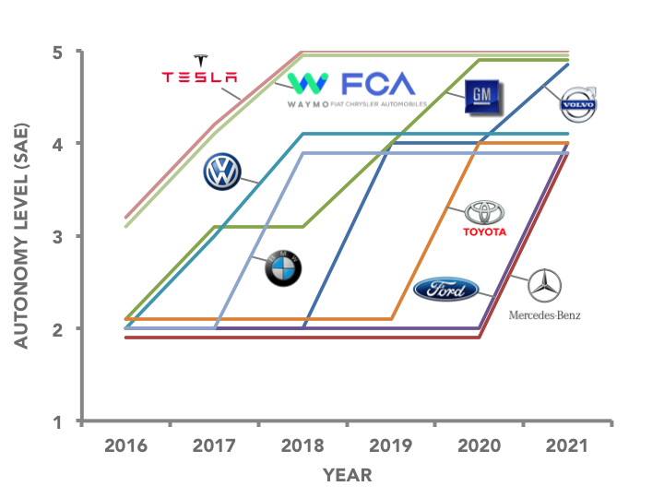
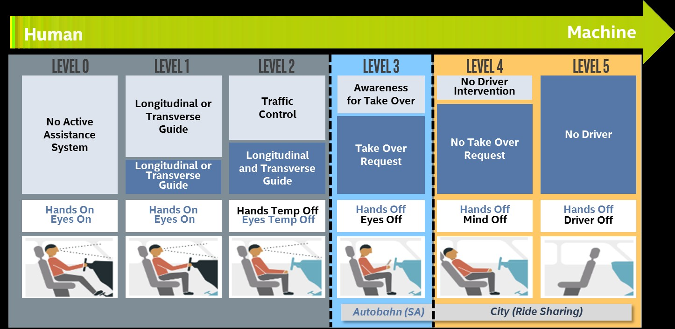
Autonomous vehicles
An application of DNN
The tipping point: level 3 Partial Autonomy
Image source: https://iq.intel.com/autonomous-cars-road-ahead/
Expected Timeline for Full Autonomy
Source: https://thelastdriverlicenseholder.com/2016/12/29/expected-timeline-for-full-autonomy/

Slide 21
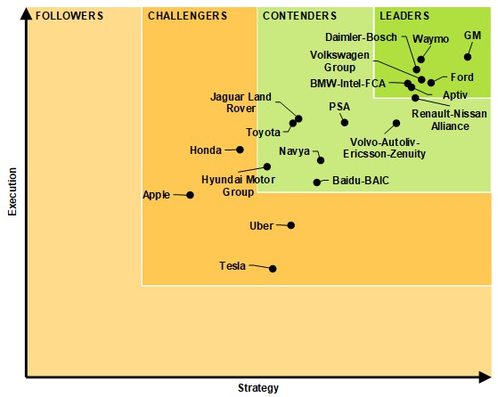
Navigant Research Leaderboard
Automated Driving Vehicles
Source: https://www.navigantresearch.com/research/navigant-research-leaderboard-automated-driving-vehicles

Slide 22
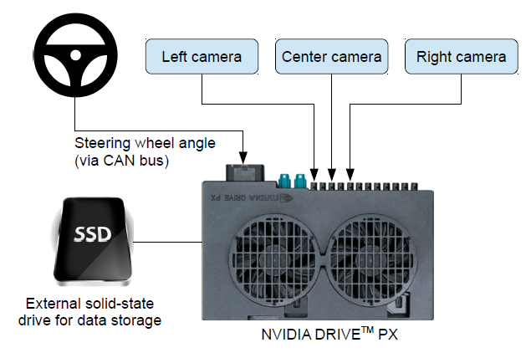
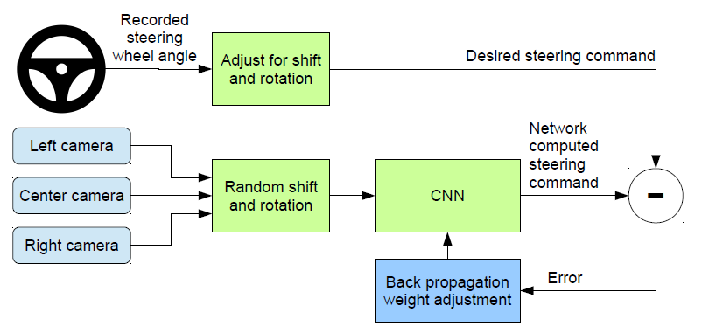
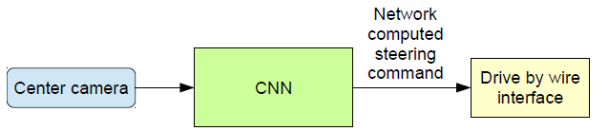
End to End Learning for Self-Driving Cars
arXiv:1604.07316v1, Apr 2016, from NVIDIA
Basic idea: behavioral cloning, train the car to drive like you do
Uses CNN to map images from cameras to steering commands
Never explicitly train the CNN to detect/follow lanes, path planning, etc.
High-level view of the data collection system Training the CNN Self-driving

Slide 23
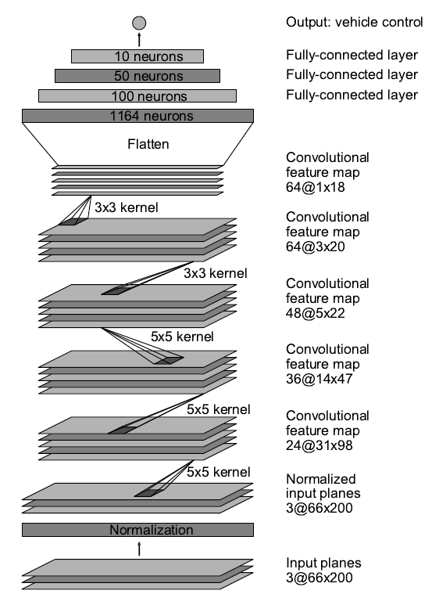
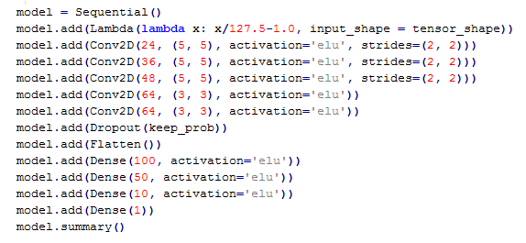
CNN architecture and the core source code
Source: github, the NVIDIA 2016 paper implementation
Read it from bottom up. Input layer, normalization layer, 5 conv2D layers: feature extraction. 3 fully-connected layers, output: controller.
27M connections, 250K parameters, 3MB in size. Source: arXiv:1604.07316v1

Slide 24
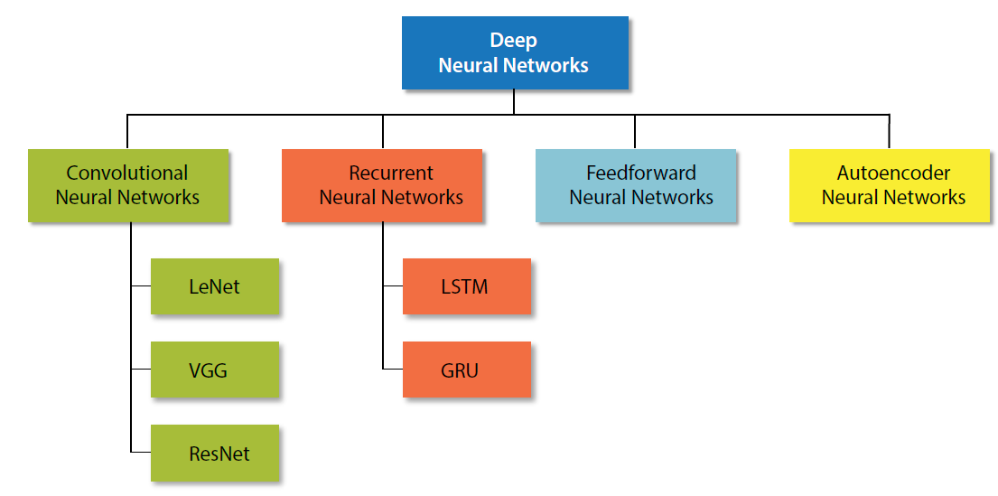
DNN supported by SAS

Slide 25
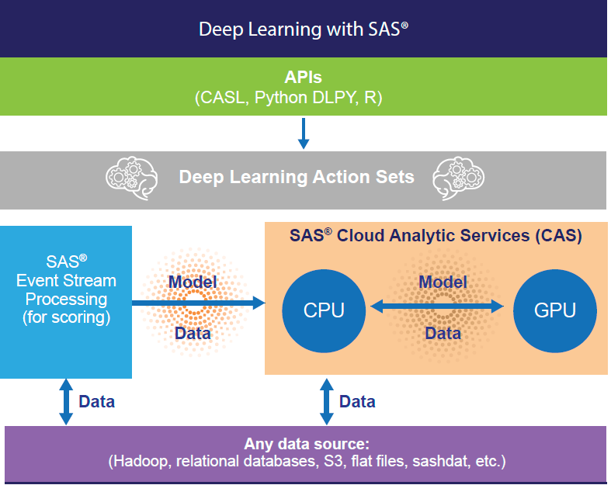
SAS platform for DNN

Slide 26
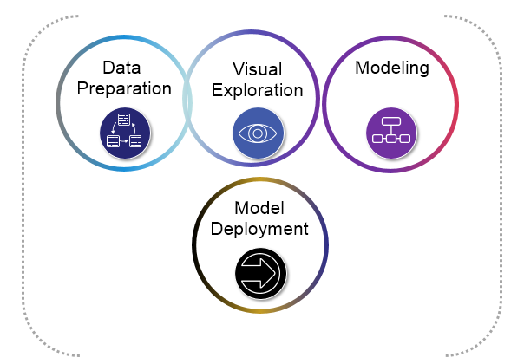
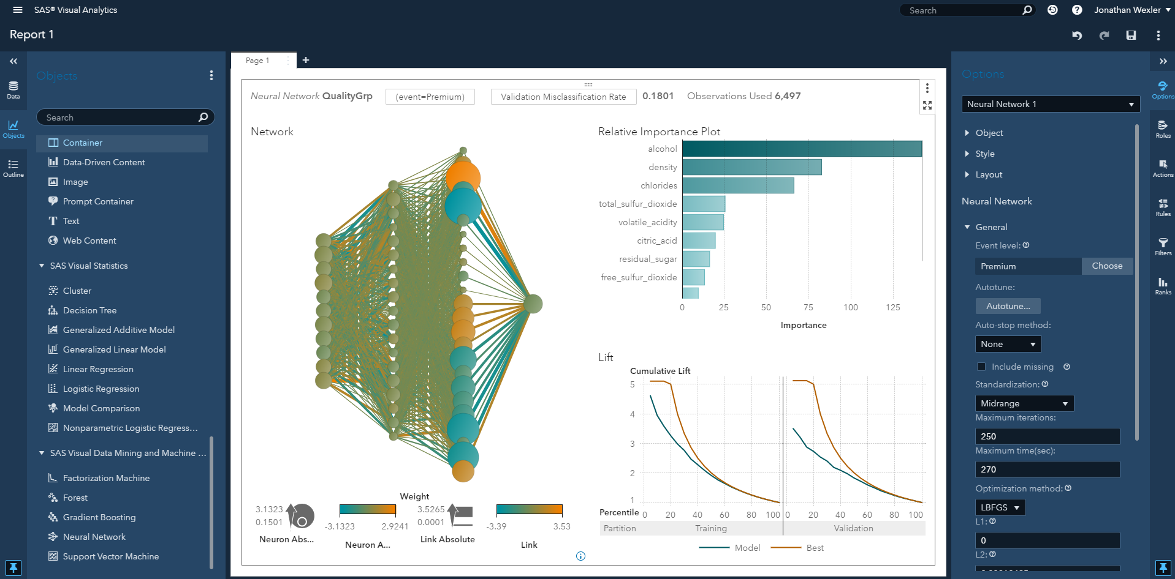
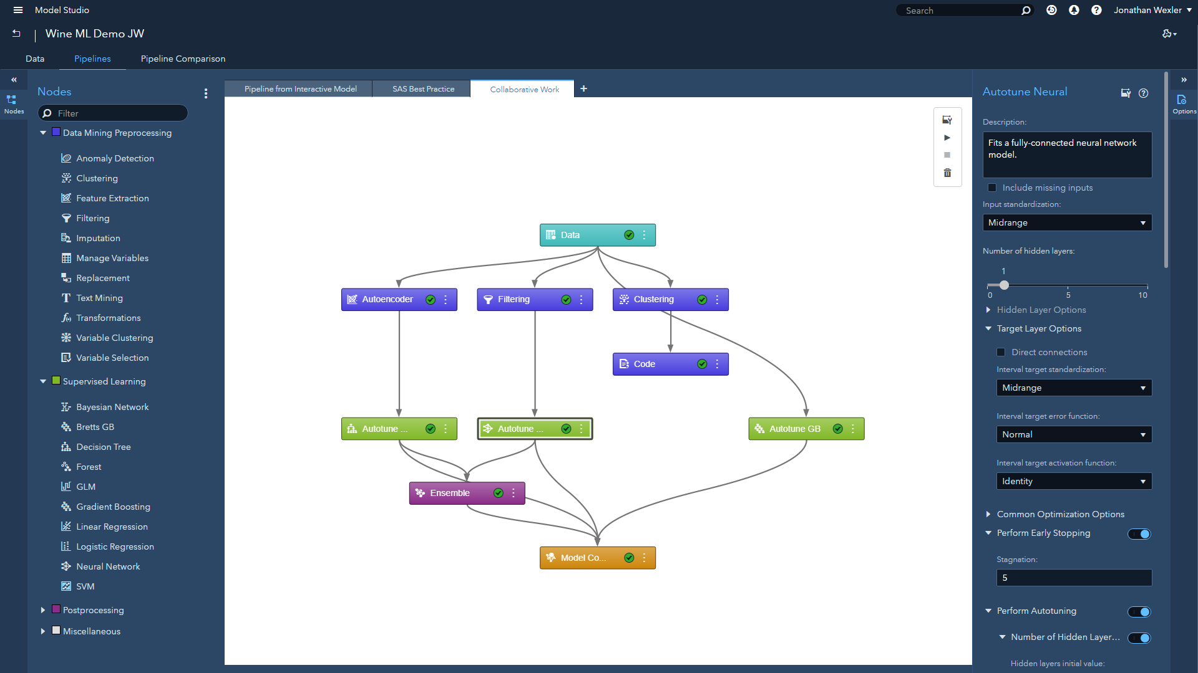






SAS® Visual Machine learning and Machine Learning (VDMML)
Visual “drag & drop” GUI

Slide 27
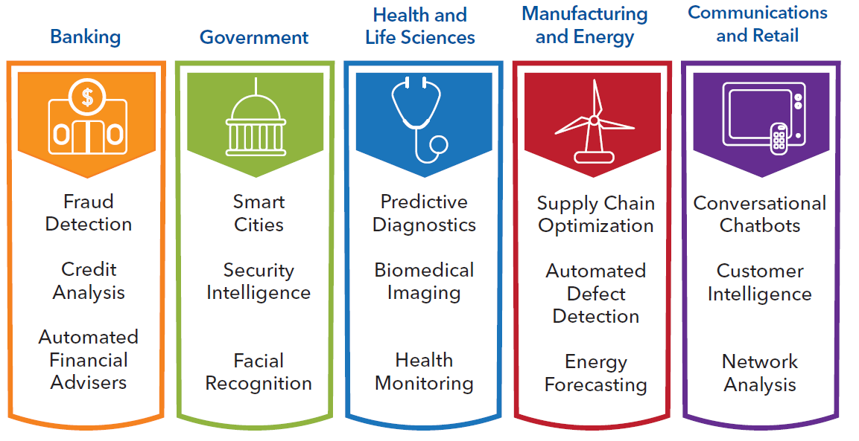
Applications of SAS DNN

Slide 28
Part 2:
Alternatives to DNN

Slide 29
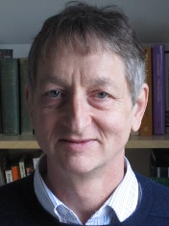
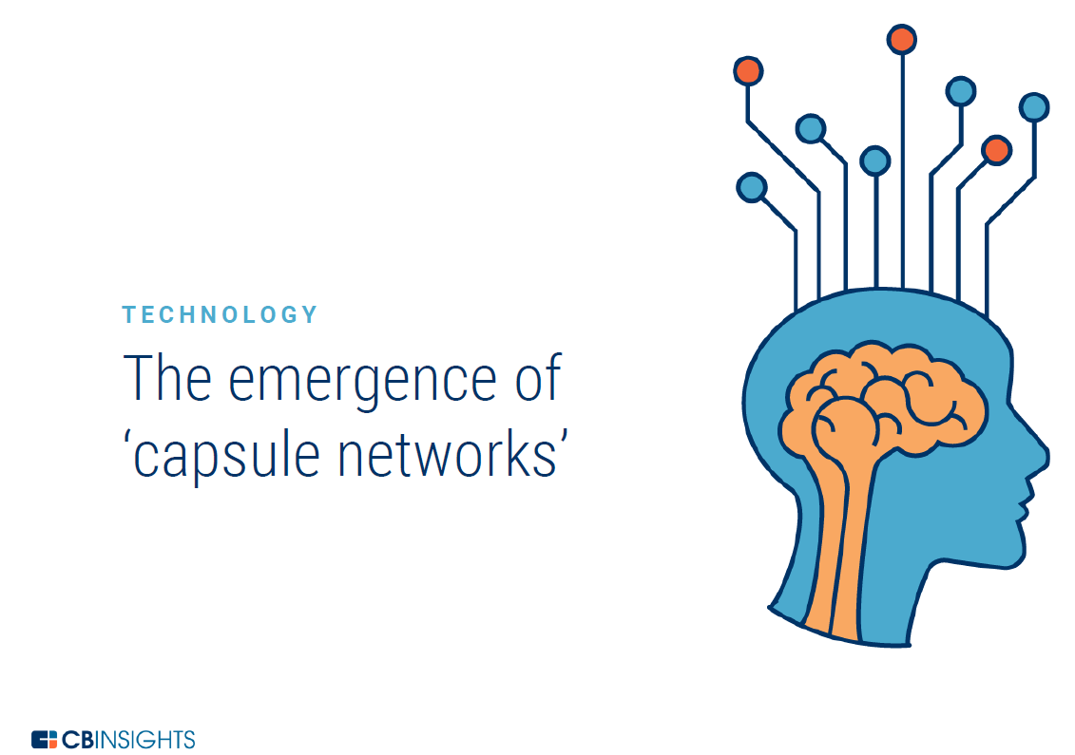
Alternative #1: CapsNet
Shallow nets can be as good as deep nets
Dynamic Routing Between Capsules, S. Sabour, N. Frosst, G. Hinton, Google Brain, NIPS 2017, https://arxiv.org/abs/1710.09829
Introduced years ago by Hinton, but was not working properly until now
Widely considered as the beginning of a new chapter of deep learning
A follow-up paper - Matrix Capsules With EM Routing
https://openreview.net/pdf?id=HJWLfGWRb, ICLR 2018
Introduced capsule convolution layer and more sophisticated routing
Source: http://www.cs.toronto.edu/~hinton

Slide 30
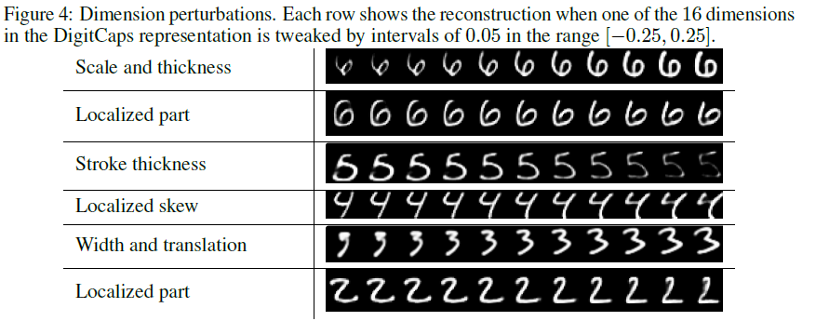
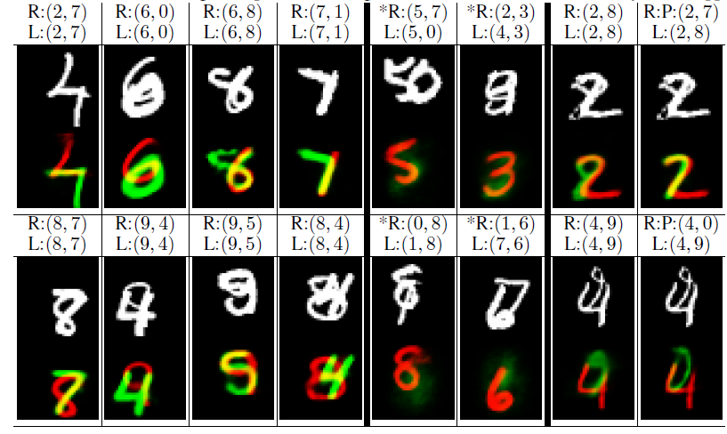
Motivation: challenges of CNN
Too deep → Shallow nets can be as good as deep nets
Interpretability → better interpretability
Image segmentation → better image segmentation
source: https://arxiv.org/abs/1710.09829

Slide 31
Dynamic Routing Between Capsules
Idea #1: capsule is an encapsulated vector/matrix in the network
A capsule is a group of neurons that represents the parameters of some specific feature.
A vector or matrix is extended from a scalar
The length represents the probability of the presence of a feature or an object
Each dimension within the capsule represents the detailed information of location, size, orientation, etc.
Idea #2: routing by agreement
Lower-level capsule (which is near input) prefers to send its output to higher-level (which is near output) capsules with “similar” prediction
Cosine similarity is used to measure the agreement

Slide 32
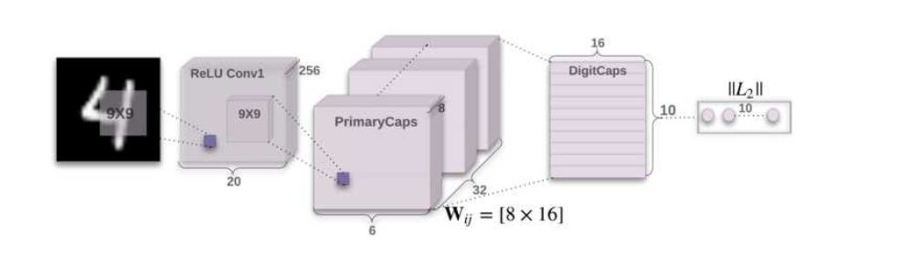
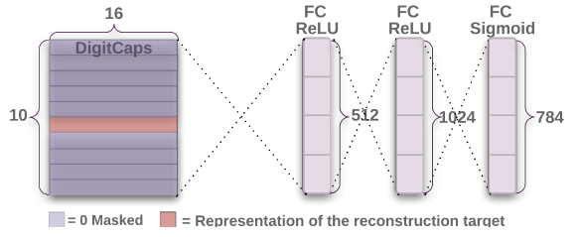
CapsNet Architecture
Figure 1: A simple CapsNet with 3 layers Figure 2: Reconstruct a digit from the DigitCaps layer representation
source: https://arxiv.org/abs/1710.09829
Input: MNIST dataset
ReLU conv1: extracts local features
PrimaryCaps: forms new neural unit (capsule)
DigitCaps: contains 10 capsules (number 0 to 9)
Cosine similarity (routing) is applied between PrimaryCaps and DigitCaps
Reconstruction: a regularization method to encourage the capsules to encode the input digit

Slide 33
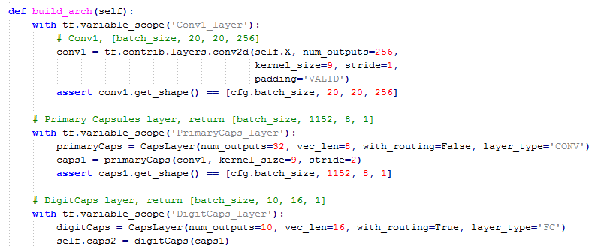
Core source code
Source: github, the NIPS 2017 paper implementation

Slide 34
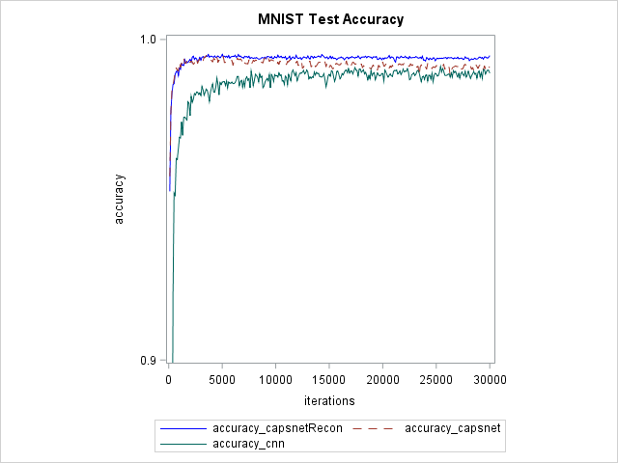
Numerical results of the NIPS paper

Slide 35
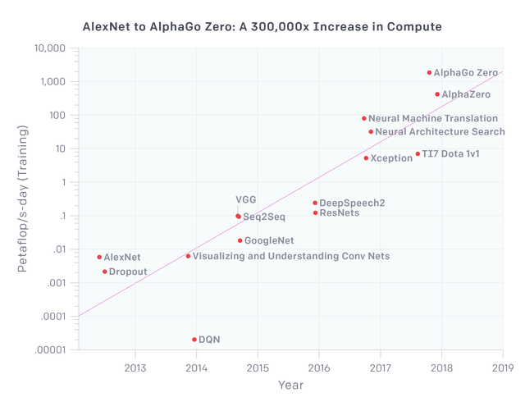
Alternative #2: DeepForest
One of motivations is: the computing power cannot catch up!
Source: https://blog.piekniewski.info/2018/05/28/ai-winter-is-well-on-its-way/

Slide 36
Deep Forest paper series
Why always Neural Nets? We can do DL using Decision Trees!
Deep Forest [10], using RF to do DL with the “3 key ingredients”:
In-model feature extraction and transformation, end-to-end machine learning
Layer by layer processing, distributed representation learning
Complex model
AutoEncoder by Forest [11]
The first tree ensemble based auto-encoder
Multi-Layered Gradient Boosting Decision Trees [12]
A variant of target propagation, pseudo-mapping F, pseudo-inverse-mapping G, pseudo-label Z (F-G-Z framework)

Slide 37
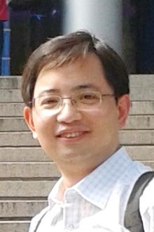
Deep Forest paper
IJCAI 2017 paper [10], by Zhou and his student
DeepForest = Forest ensemble, double-happiness (ensemble of ensembles)
Multi-grain scanning, sliding window to extract features
Cascade of multiple random forests layers, for prediction
Very few hyper-parameters (how nice!) & as good as DNN
Default settings are good for many applications
Non-differentiable model, no back propagation
Source: https://en.wikipedia.org/wiki/Zhi-Hua_Zhou

Slide 38
Deep Forest paper
Problems of DNN
Too many hyper-parameters (like an art rather than science)
Does not work well for small data
Model architecture/complexity is determined in advance (via tuning)
Often overly complicated
Shortcut connection, pruning, binarization, etc. are often applied

Slide 39
Deep Forest paper
Why deep forest? Motivation?
Decision trees
Architecture learning
Data driven
Almost unbeatable on tabular data in Kaggle
Motivation
DL = DNN?
Can we do DL with non-differentiable models (no back-propagation)?
Maybe repeatable results (think SGD)?

Slide 40
Deep Forest paper
Inspiration from DNN
Distributed representation learning (end to end, in-model feature trans.)
Layer-by-layer processing
Model complexity

Slide 41
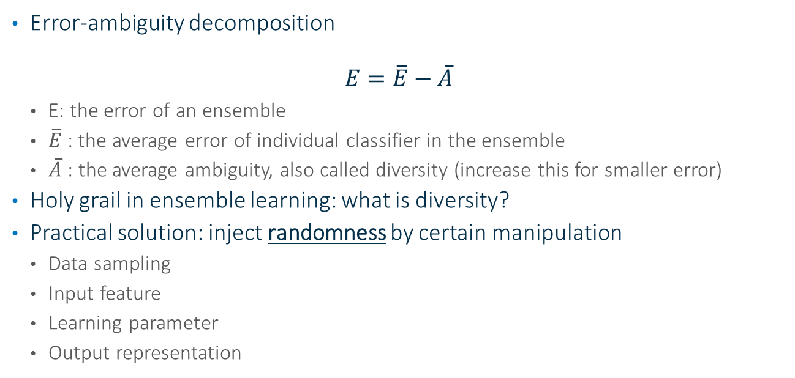
Deep Forest paper
Inspiration from Ensemble Learning
Error-ambiguity decomposition
$$E=\overline{E}−\overline{A}$$
E: the error of an ensemble
$\overline{E}$: the average error of individual classifier in the ensemble
$\overline{A}$ : the average ambiguity, also called diversity (increase this for smaller error)
Holy grail in ensemble learning: what is diversity?
Practical solution: inject randomness by certain manipulation
Data sampling
Input feature
Learning parameter
Output representation

Slide 42
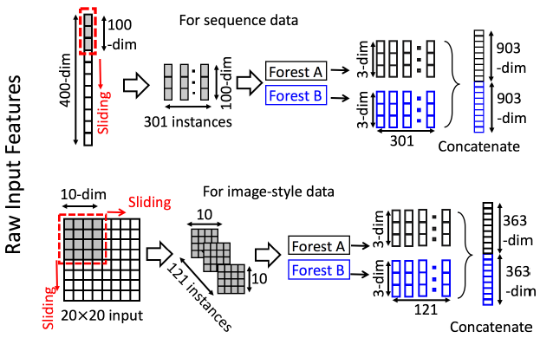
Deep Forest paper
Multi-Grained Scanning for Feature Engineering
Sequential relationships are important
Spatial relationships are important

Slide 43
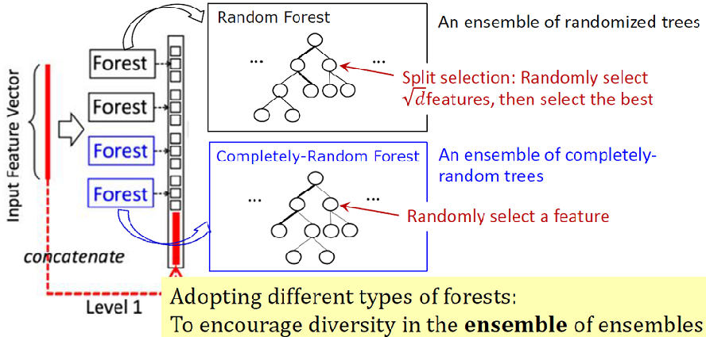
Deep Forest paper
Cascade Forest Structure for Prediction
Ensemble of ensembles
K-fold cross validation
Architecture learning (stop growing when satisfied)

Slide 44
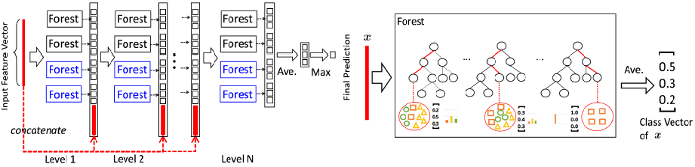
Deep Forest paper
Class Vector Generation

Slide 45
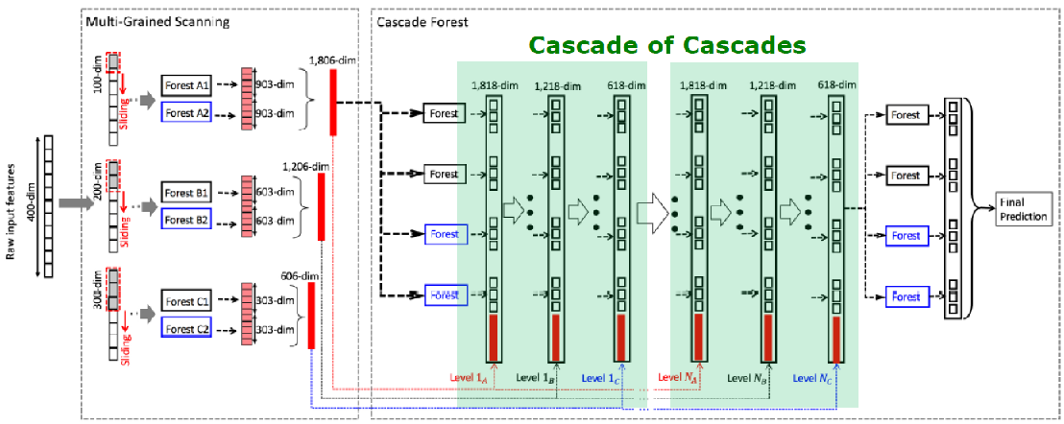
Deep Forest paper
Overall Architecture

Slide 46
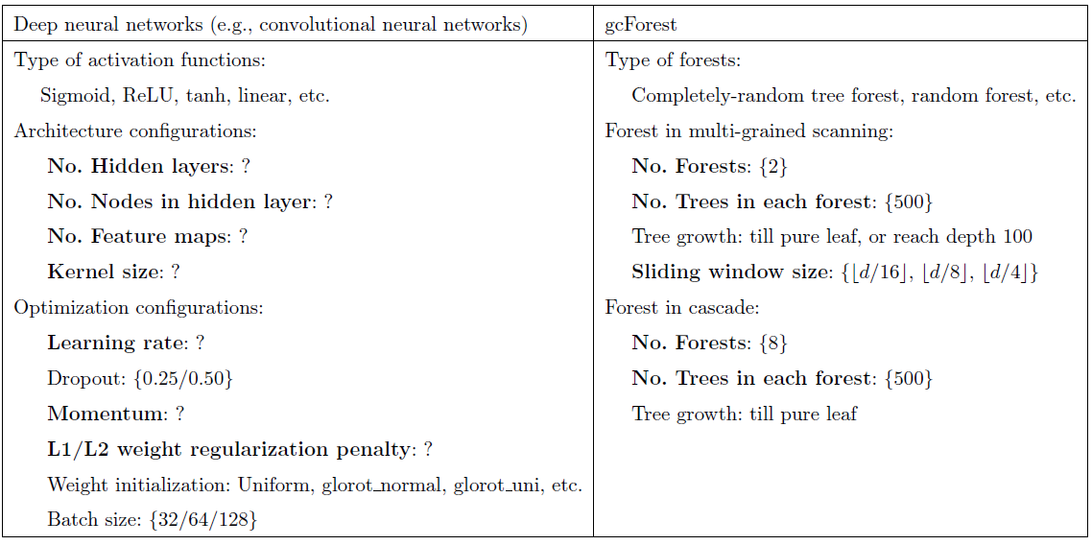
Deep Forest paper
Hyperparameters and default settings

Slide 47
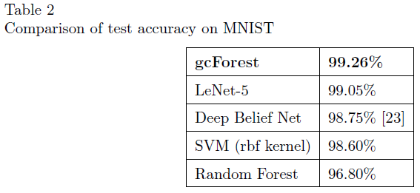
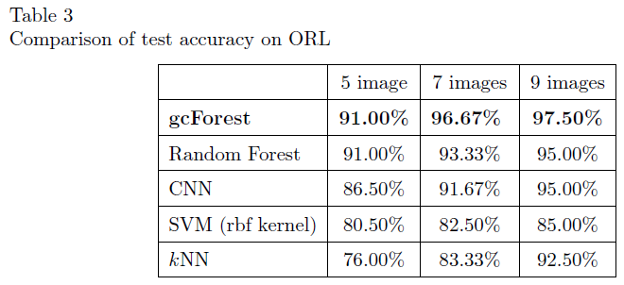
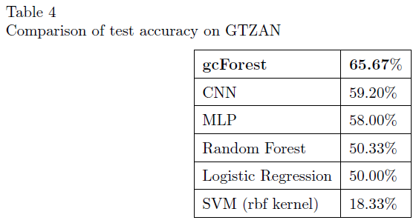
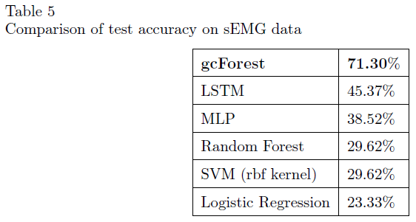
Deep Forest paper
Experimental results
Image Categorization
Face Recognition
Music Classification
Hand Movement Recognition

Slide 48
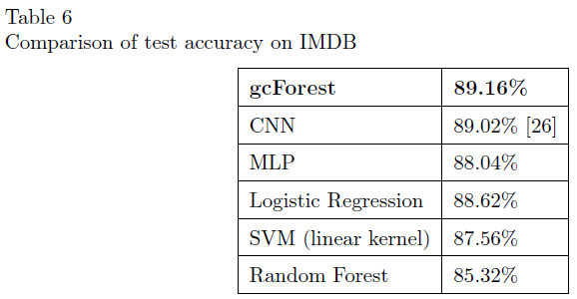
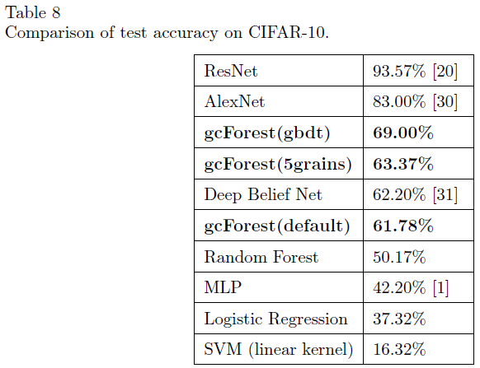
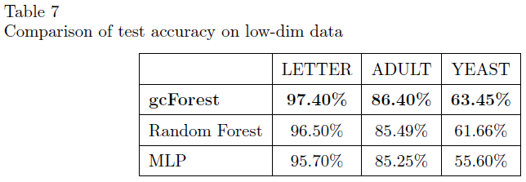
Deep Forest paper
Experiments
Sentiment Classification
High-Dimensional Data
(hard to beat successful method
at its killer-app with
a brand-new algorithm)
Low-Dimensional Data

Slide 49
Deep Forest paper
Running time
PC with 2 Intel E5 2695 v4 CPUs (18 cores)
IMDB dataset (25,000 examples, with 5,000 features)
Deep Forest: 40 minutes
DNN: can take over 60 minutes

Slide 50
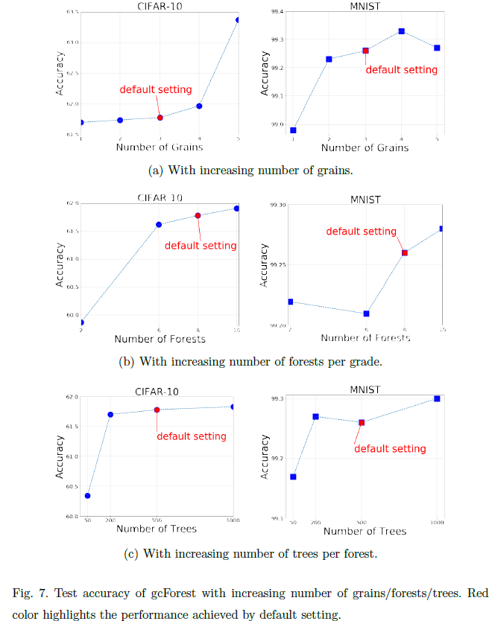
Deep Forest paper
Hyperparameter sensitivity

Slide 51


Related areas
Reinforcement learning (play, explore, control, interact)
An agent selects actions to maximize reward in an environment
AI = Deep RL (D. Silver, 2016) vs. RL does not really work (I. Goodfellow, 2018)
Generative adversarial networks (GAN) [9]
Unsupervised learning using supervised learning as sampling model
Infers models in a competing game with Generator (G) and Discriminator (D)
Provides an attractive alternative to maximum likelihood techniques.
Y. LeCun: “…There are many interesting recent development in deep learning…The most important one, in my opinion, is adversarial training….”
Adaptive Neural Trees (ANT), https://arxiv.org/abs/1807.06699, 17 Jul 2018
NN: end2end/distributed representation learning with pre-specified architecture, image/sequence
DT: architecture learning with pre-specified features, tabular data

Slide 52

AI winter is coming?
Source: https://blog.piekniewski.info/2018/05/28/ai-winter-is-well-on-its-way/
Image sources: Google trend

Slide 53


Closing Remarks
AI and machine learning are very hard – just keep trying!

Slide 54
Key References
[1] Y. LeCun et al., Handwritten Digit Recognition with a Back-Propagation Network, NIPS 1989.
[2] Y. Lecun et al., Gradient-Based Learning Applied to Document Recognition, 1998, Proceedings of the IEEE.
[3] D. Silver, A. Huang, et, al. (2016). "Mastering the game of Go with deep neural networks and tree search". Nature 529 (7587): 484–489.
[4] W. Thompson, et al., Introduction to Deep learning, SAS, 2016.
[5] X. Hunt, et al., Machine Learning Landscape, SAS, 2017.
[6] Tutorial: Deep Reinforcement Learning, David Silver, 2017.
[7] White paper: How to Do Deep Learning With SAS? 2018.
[8] Y. LeCun, et al., Deep learning, Nature, 2015.
[9] Generative Adversarial Net, I. Goodfellow, et al., https://arxiv.org/abs/1406.2661
[10] Zhi-Hua Zhou and Ji Feng, Deep Forest, IJCAI 2017.
[11] AutoEncoder by Forest, Ji Feng and Zhi-Hua Zhou, AAAI 2018.
[12] Multi-Layered Gradient Boosting Decision Trees, Ji Feng, Yang Yu, Zhi-Hua Zhou, https://arxiv.org/abs/1806.00007, 2018

Slide 55

Upcoming event
Shameless ads
10/10/2018: paper (or extended abstract) submission deadline
The Second International Workshop on Automation in Machine Learning (AutoML), Seattle, WA, December 10-13, 2018
A Best Paper Award will be presented during the workshop
https://sites.google.com/view/automl-workshop
http://www.wikicfp.com/cfp/servlet/event.showcfp?eventid=77597
Free images of Seattle downloaded from pixabay.com

Slide 56
AMA
(Ask Me Anything)

